Slide 1



Slide 2
We are going to organize a motor expo where we will take different brands and there will be some sponsors like Campa, Pepsi, Monster, Dada Boudi, Bawarchi there will be some banks like ICICI, Bank of India, Indusind Bank, state bank of india and Mahindra finance which will do on spot financing. It will be for 2 days there will be some activity, entertainment like a fashion show, magician, quiz competition and many more activity like that where 2000 people will gather daily, the brand will get good inquiries, leads will be generated, sales will happen….
Setup..
10 x 10 tent with brand backdrop
Stand fan
Metal light 2 nos
2 pc chair
Table with frill
Stage with sound light and led backdrop
Hostess for registration and data collection on car display area
( 1 nos ) Each brand
16 x 10 platform carpet with backdrop for car display
Event and entertainment
Day 1) quiz completion, Magic show, group dance
Day 2) singing, fashion show with Brand Visibility, stand-up comedy
Female Anchor for Event Host
Date : 19th and 20th july
Time : 10 am to 8 pm
Location : Patuli Play ground
Contact : 9836540414,8910973209,9679134109

Slide 3
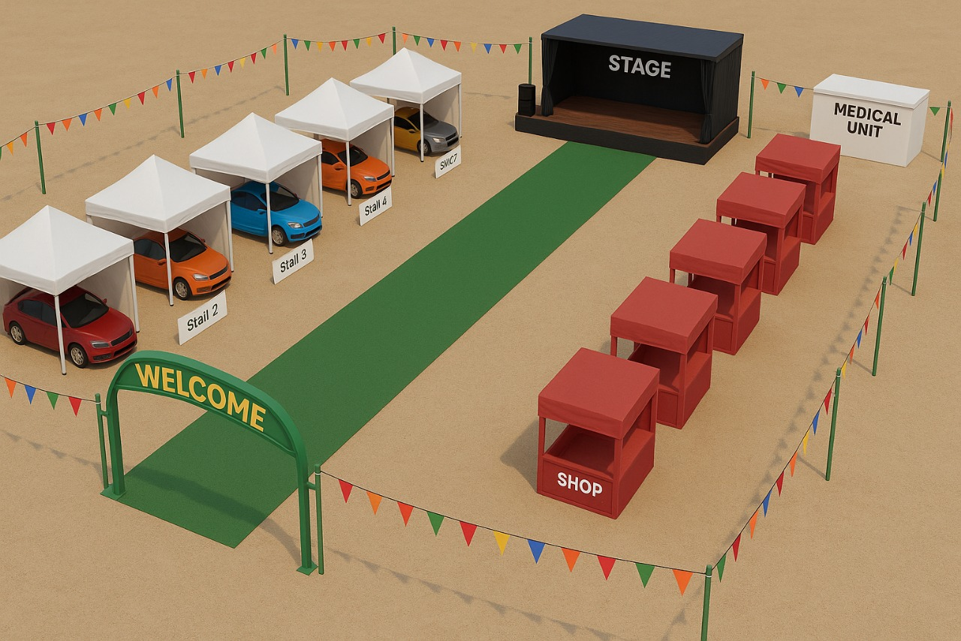
Main Expo Area

Slide 4
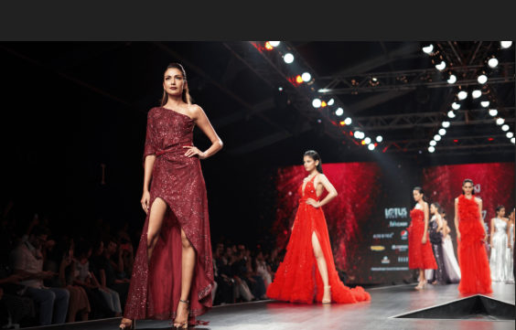
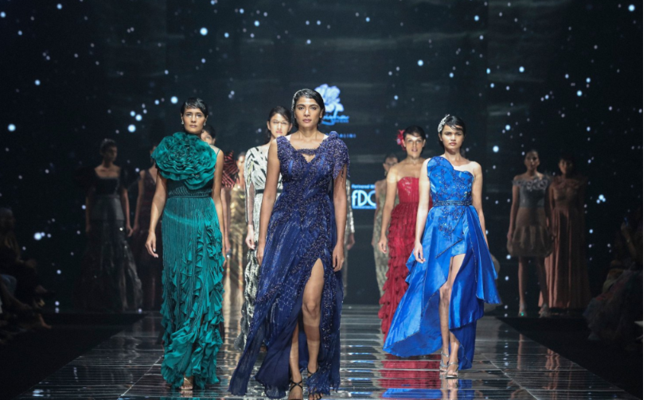
Fashion Show

Slide 5
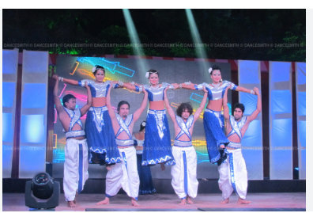
Group Dance

Slide 6
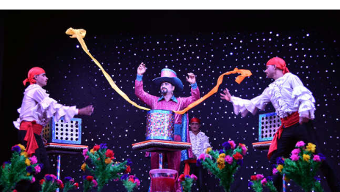
Magic Show Show

Slide 7
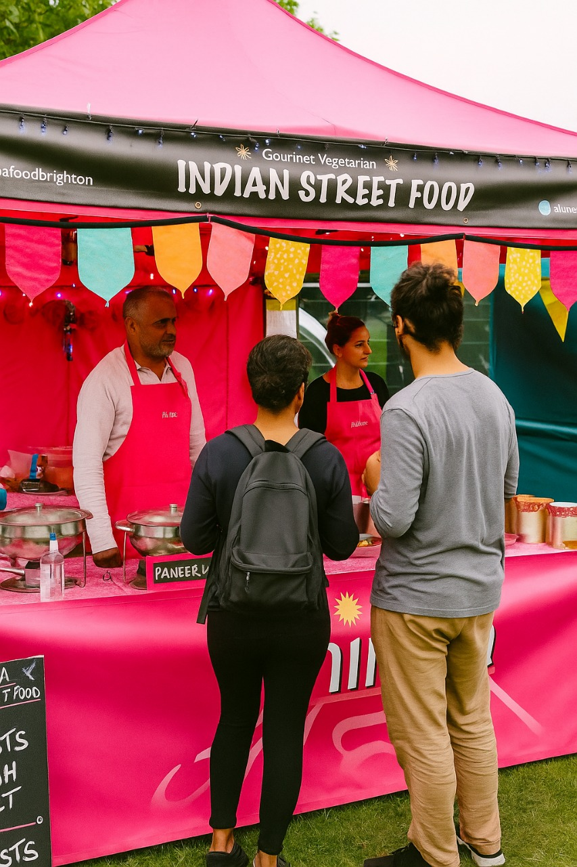
Stall Activity

Slide 8
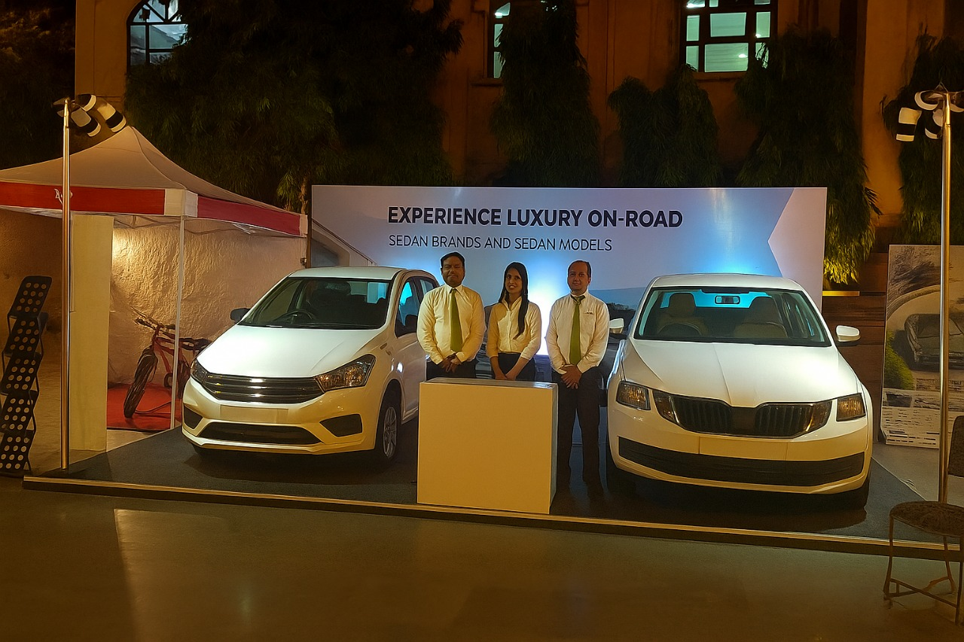
Car display

Slide 9
Thank you
Visit : https://vaisproductions.com/expo
For Spot Booking – 9836540414,9679134109,8910873209

